Slide 1
Flower Image Classifications
Md Asraf Uddin Rafi Dept. of CSE(7th sem) 0562210005101007 Course Code: CSE-460 Institution: North East University Bangladesh

Slide 2


Introduction
Brief overview of image classification and its applications.
Build a CNN model to classify flower images into different categories.

Slide 3


Dataset Overview
Dataset structure: Images organized in folders by class.
Number of classes: 5 flower categories.
Splitting dataset into training (80%) and validation (20%).
Batch size set to 32 for efficient processing.
Explanation of data augmentation to improve model generalization.

Slide 4
Image Classification Function
How to classify new images using the trained model.
Steps:
Load and preprocess image.
Predict class probabilities.
Output predicted class and confidence score.
Example classification result on a sample image.

Slide 5
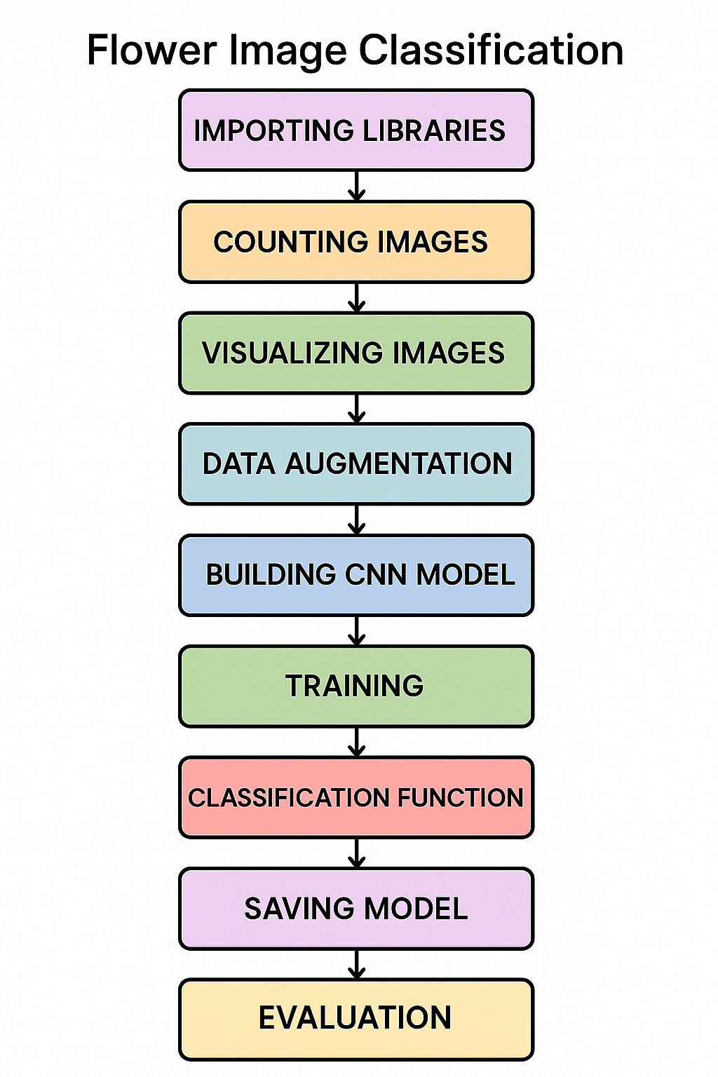
Model Architecture
Data augmentation layer
Rescaling layer (normalization)
3 Conv2D + MaxPooling2D blocks (filters: 16, 32, 64)
Dropout layer (20%) to reduce overfitting
Flatten layer
Dense layer with 128 neurons (ReLU activation)
Output Dense layer with 5 neurons (one per class)

Slide 6
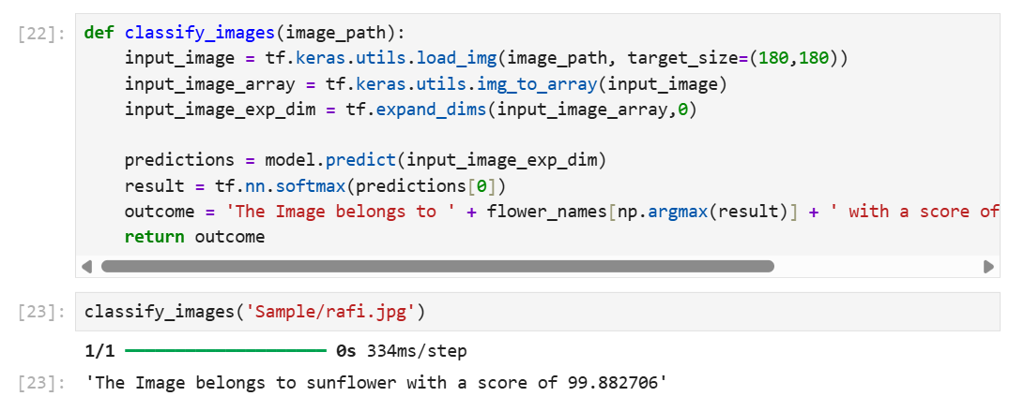
Model prediction Overview

Slide 7
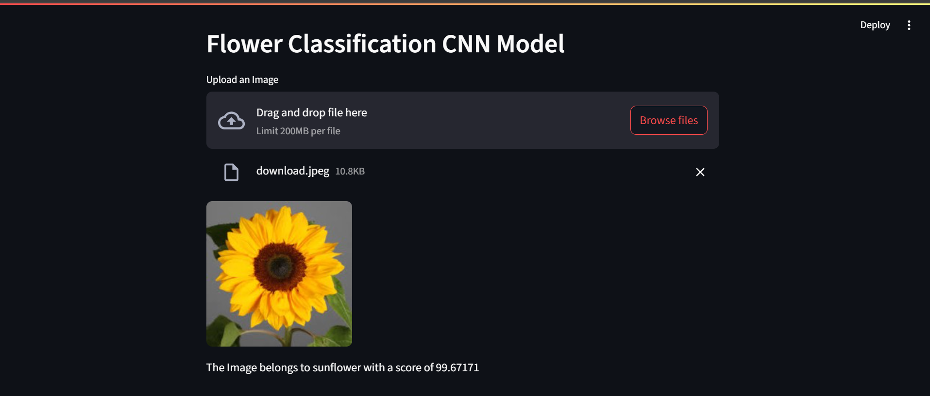
User Interface

Slide 8
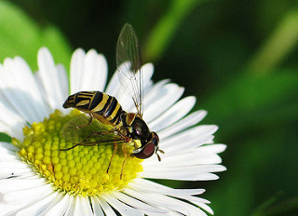
Challenges and Improvements
Challenges faced (e.g., limited data, overfitting).
Possible improvements:
More data or data augmentation.
Transfer learning with pre-trained models.
Hyperparameter tuning.

Slide 9
Reference
TensorFlow: Large-Scale Machine Learning on Heterogeneous Distributed Systems https://arxiv.org/abs/1603.04467
Keras https://keras.io/
TensorFlow Documentation https://www.tensorflow.org/api_docs
NumPy: Array programming with NumPy https://numpy.org/
Matplotlib: A 2D graphics environment https://matplotlib.org/
Python os Module Documentation https://docs.python.org/3/library/os.html

Slide 10
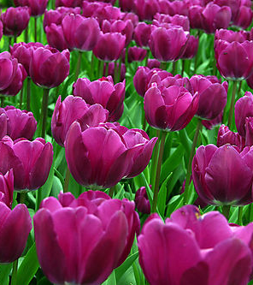
Conclusion
Summary of the approach and results.
Importance of CNNs in image classification.
Future directions and applications.

Slide 11
Thank you
Any Questions?

